Slide 1
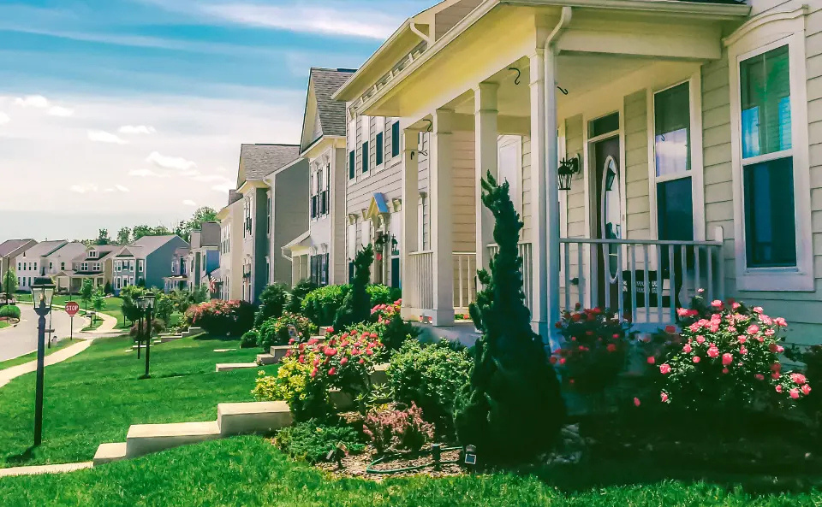
THE NEST
MODERN LIVING SIMPLIFIED

Slide 2




OUR TEAM
Aishwarya
Elizabeth
Amith
Wilson
Lubaina
Raja
Sharvari
Dethe

Slide 3
EXECUTIVE SUMMARY
1
3
Project
Overview
Creation
Process
Application
Demo
Enhance apartment searching using digital tools for a better prospective tenants experience
App was refined based on user feedback, featuring intuitive design and scalable technology
Simplifies property search and comparison for tenants with detailed listings and interactive maps
2

Slide 4



PROSPECTIVE TENANTS CHALLENGES
Inefficient Search Processes
Lack of Detailed Information
Limited Rating Comparison
Poor Location Insights
Inconsistent Communication

Slide 5



THE NEST CUSTOMIZABLE SEARCH
Search Parameters
Availability Status
Location and Proximity
Search by type, budget, and furnishing
Filter apartments based on move-in availability
View properties in desired neighborhoods with proximity to workplaces, schools, or essential services

Slide 6
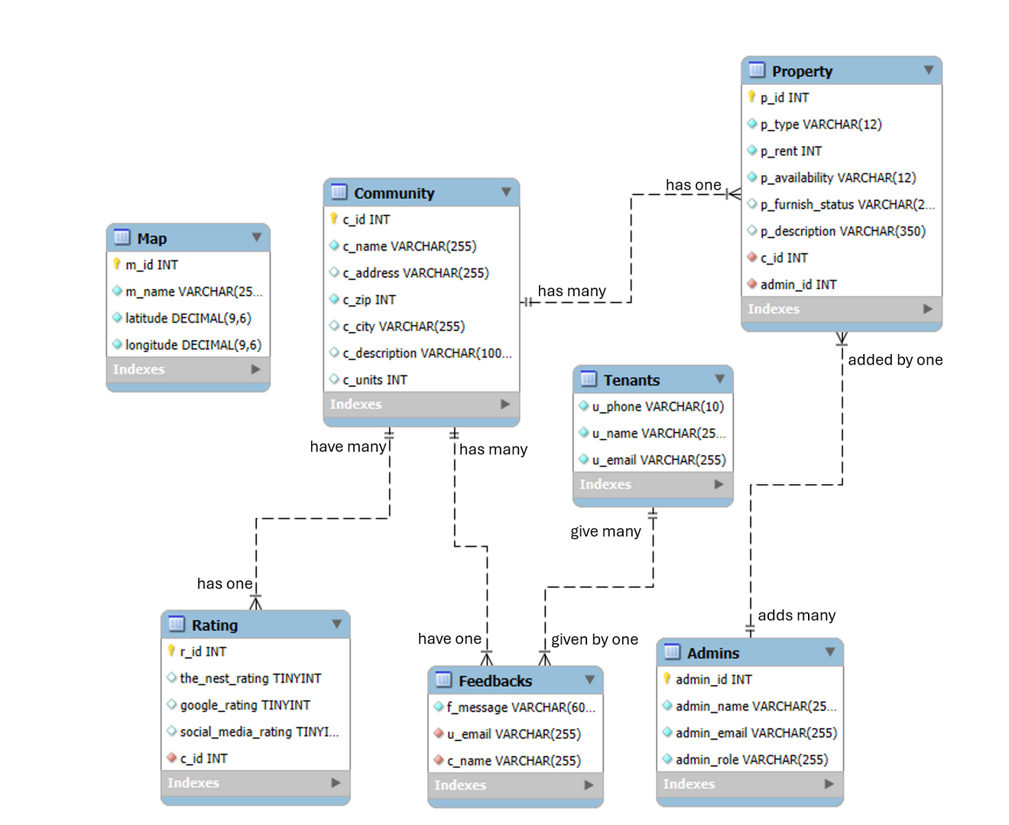
ERD DIAGRAM

Slide 7
C.R.U.D
Create
Read
Add tenant accounts and new property listings with details like pricing and features
Browse property details and community information
Update
Delete
Add tenant accounts and new property listings with details like pricing and features
Remove outdated property and community listings

Slide 8
APPROACH & CHALLENGES
Approach
Challenges
Built the app using an ERD, sample database, and R Shiny
Translate ideas into an ERD, normalize relationships, and create a functional app in R Shiny
Learning
Experience
Learned to adapt visions into functional apps with innovative interfaces

Slide 9

APPLICATION DEMO

Slide 10
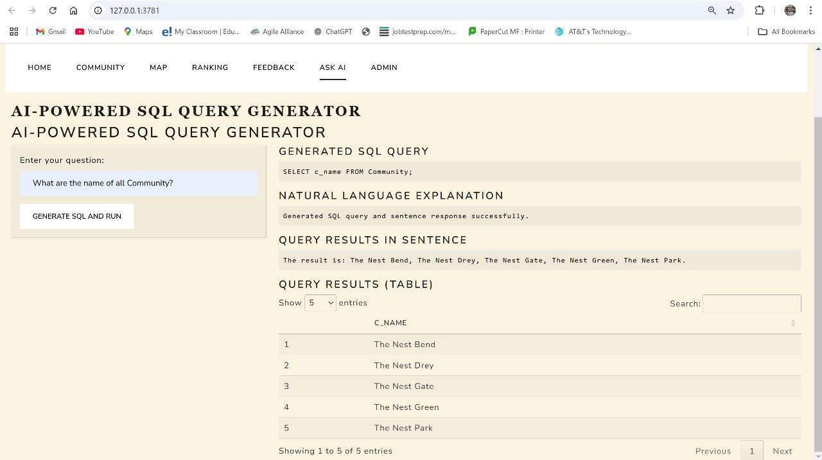
LLM INTEGRATION

Slide 11
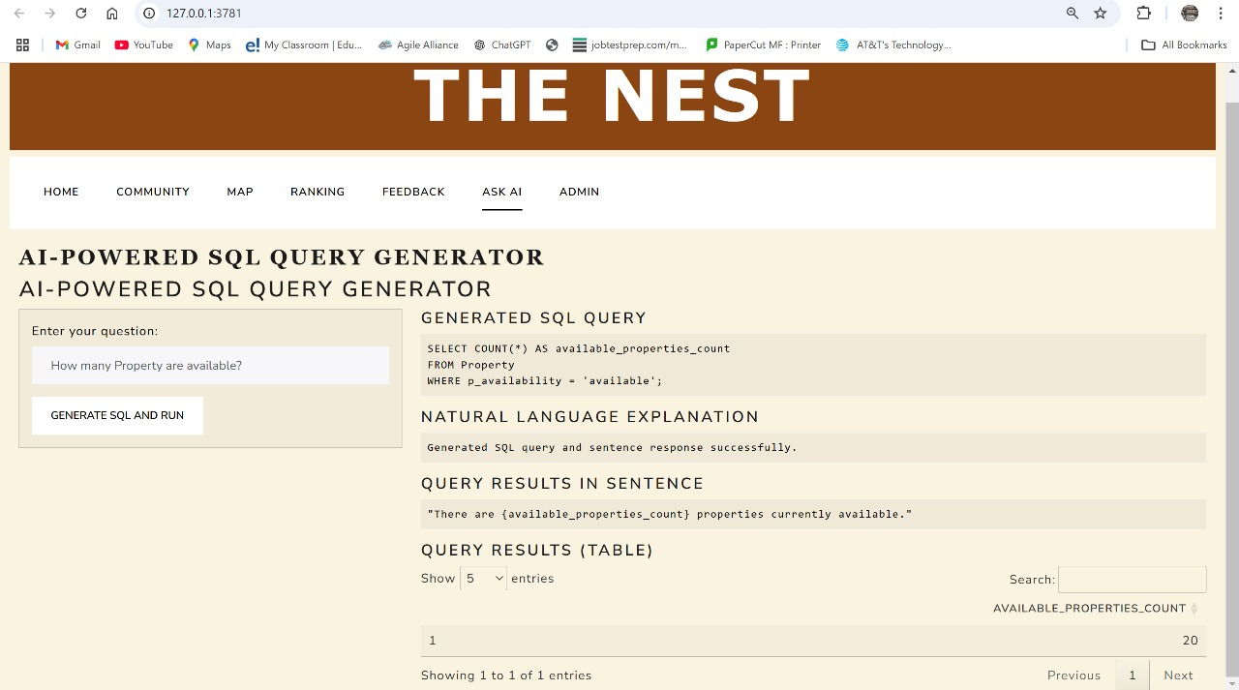
LLM INTEGRATION

Slide 12


